Slide 1
Hadoop : A Highly Available and Secure Enterprise Data warehousing Solution

Slide 2
Agenda
At the end of this webinar we will Know about:
What is Big Data
Why do Enterprise care about Big Data
Why your DWH needs Hadoop?
Security in Hadoop
How Hadoop maintains high Availability
Data warehousing tools in Hadoop
Hands on

Slide 3

What is Big Data

Slide 4


Slide 5

What is Wrong with our traditional DWH Solutions

Slide 6
When RDBMS Makes no Sense?
Storing images and video
Processing images and video
Storing and processing other large files
PDFs, Excel files
Processing large blocks of natural language text
Blog posts, job ads, product descriptions
Processing semi-structured data
CSV, JSON, XML, log files
Sensor data

Slide 7
When RDBMS Makes no Sense?
Ad-hoc, exploratory analytics
Integrating data from external sources
Data cleanup tasks
Very advanced analytics (machine learning)

Slide 8

Big Problems with Big Data
It is:
Unstructured
Unprocessed
Un-aggregated
Un-filtered
Repetitive
Low quality
And generally messy.
Oh, and there is a lot of it.
Notes:
Big data is not called big data because it fits well into a thumb-drive.
It requires a lot of storage, partially because it’s a lot of data. Partially because it is unstructured, unprocessed, un-aggregated, repetitive and generally messy

Slide 9

Technical Challenges
Storage capacity
Storage throughput
Pipeline throughput
Processing power
Parallel processing
System Integration
Data Analysis
Scalable storage
Massive Parallel Processing
Ready to use tools

Slide 10
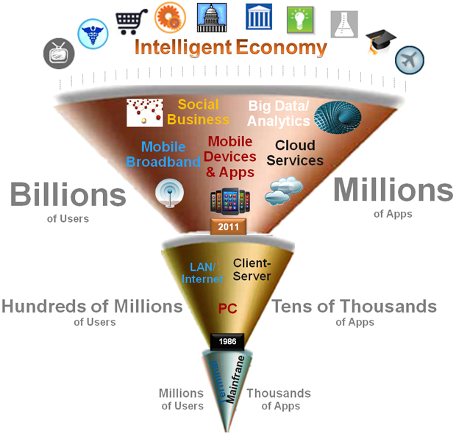
Technical Challenges
Too many channels for data

Slide 11

Why do Enterprise care about Big Data

Slide 12
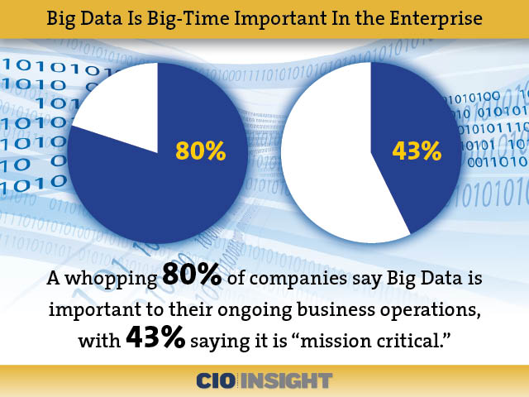

Slide 13
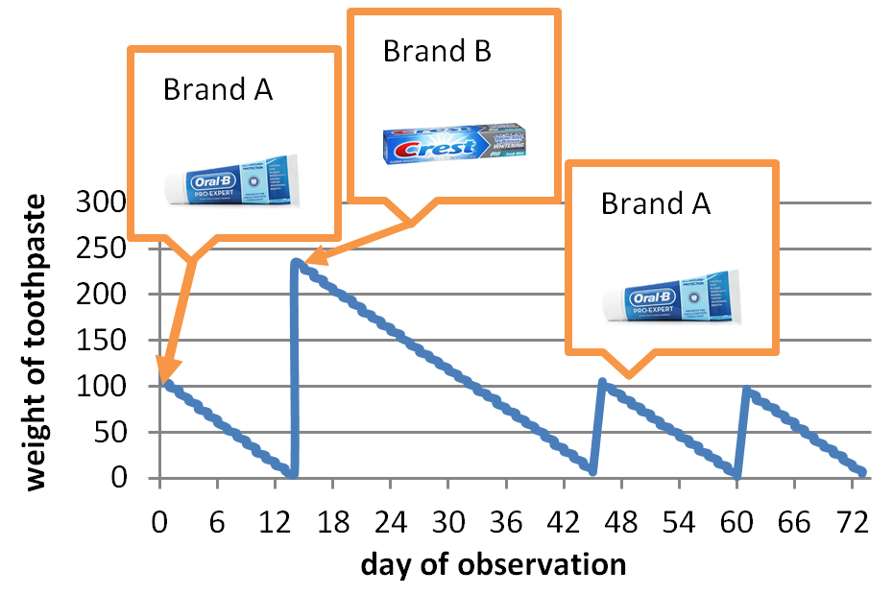

Slide 14
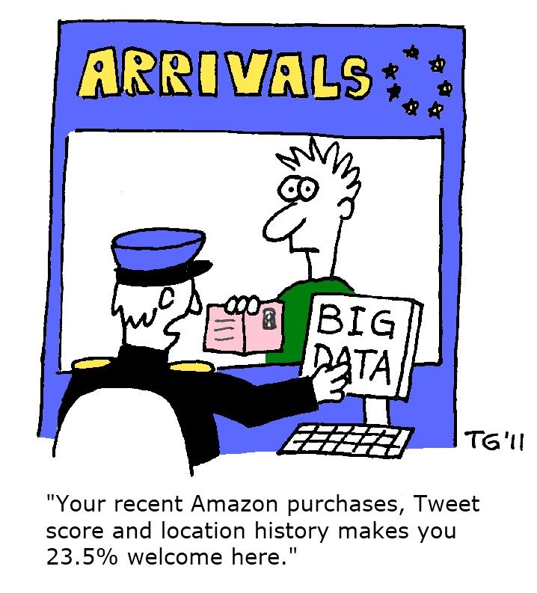
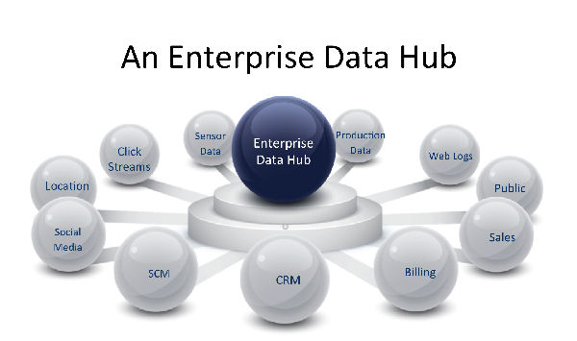

Slide 15
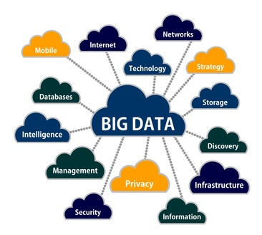


Slide 16
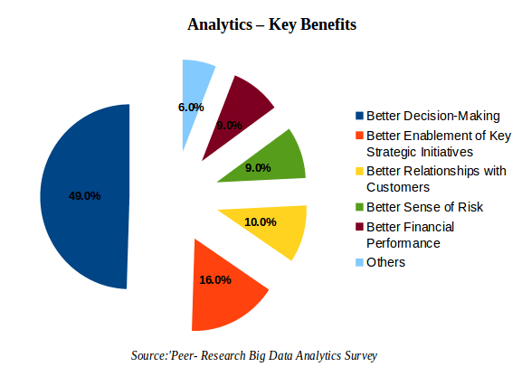

Slide 17

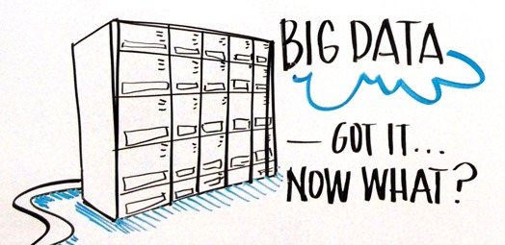

Slide 18

You said RDBMS does not have solution
for Big Data,
Then who has???

Slide 19


Hadoop : The Savior
I Have The solution for Big Data Problem
Hadoop

Slide 20
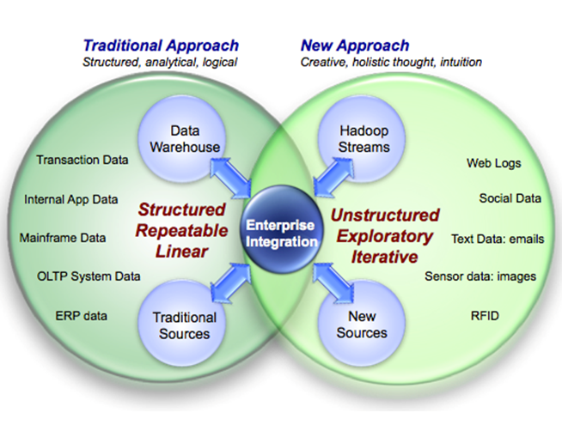
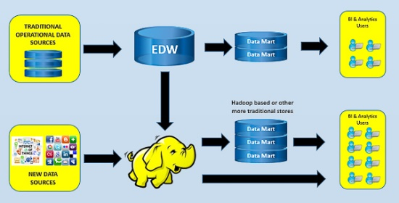
How Hadoop differs from RDBMS
Hadoop can store all types of data in it so that you have flexibility of analyzing all types of data.
You can drill down the big data to find even the rare insight which was not possible earlier.

Slide 21
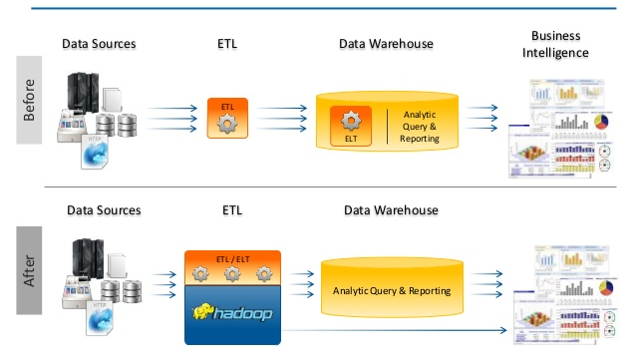
Hadoop Is The New DWH Solution
First Load the data then do whatever you want to do.
This is Possible because of the cheap storage and distributed HDFS.

Slide 22
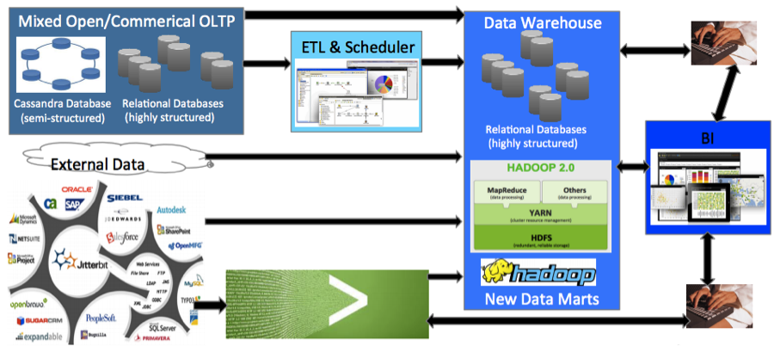
Hadoop Does ELT Not ETL
Hadoop is the new Data Warehouse for all kind of BI requirements.

Slide 23
Core Features of Hadoop

Slide 24
Hadoop is Fault Tolerant and super consistent

Slide 25
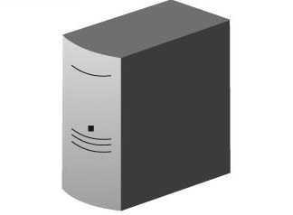
Maintaining High Availability
In Distributed Computing, failure is a norm, which means YARN should have acceptable amount of availability
Client
get Block Locations
NS
NameNode
Block Management
Read Data
Data
Node
Data
Node
Data
Node
….
NameNode - No High Availability
NameNode - No Horizontal Scale

Slide 26













NameNode – Single Point of Failure
metadata
Single Point
Failure
NameNode
Secondary NameNode:
"Not a hot standby" for the NameNode
Connects to NameNode every hour*
Housekeeping, backup of NemeNode metadata
Saved metadata can build a failed NameNode
You give me metadata every hour, I will make it secure
Secondary
NameNode
metadata

Slide 27
Hadoop 2.0 Cluster Architecture - HA
HDFS HIGH AVAILABILITY
HDFS
Client
All name space edits logged to shared NFS storage; single writer (fencing)
Shared edit logs
YARN
Read edit logs and applies to its own namespace
NameNode High Availability
Next Generation MapReduce
Secondary Name Node
Active NameNode
Standby NameNode
Resource Manager
DataNode
DataNode
Data Node
Node Manager
Node Manager
Container
App
Master
Container
App
Master
Node Manager
Node Manager
DataNode
DataNode
Container
App
Master
Container
App
Master
http://hadoop.apache.org/docs/stable2/hadoop-yarn/hadoop-yarn-site/HDFSHighAvailabilityWithNFS.html

Slide 28
Demo
Achieving HDFS and YARN High Availability

Slide 29
Hadoop is Secure

Slide 30


Security
The Hadoop ecosystem has only partially adopted Kerberos but many services remain unprotected and use trivial authentication systems.
Service-level authorization and web proxy capabilities in YARN.
Most security tools fail to scale and perform with big data environments.

Slide 31













Security – Simple Flow
Security Risks
Insufficient Authentication
Do not authenticate users services
No Privacy and No Integrity
Insecure Network Transport
No Message level security
Arbitrary Code Execution
No User verification for MapReduce code execution, malicious users could submit a job
Client
Job Tracker
Task Tracker
Task Tracker
Task
Task
HDFS
HDFS

Slide 32


Checking Resources Usage And Users Permissions
Managing users, permissions , quotas, etc

Slide 33
Demo
Demo on ACL

Slide 34
Hadoop provides traditional SQL interface as well as
NoSQL Interface foe data storage

Slide 35
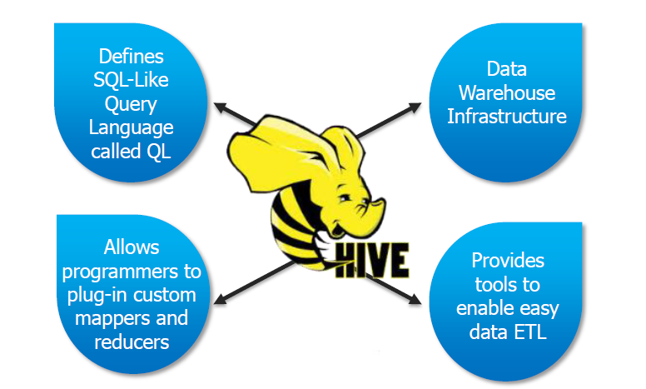
Hive ??

Slide 36
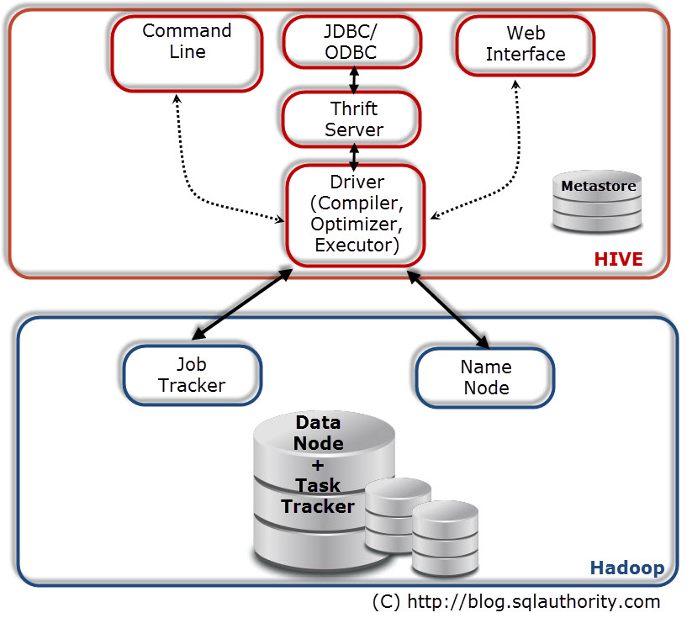
Hive Architecture

Slide 37
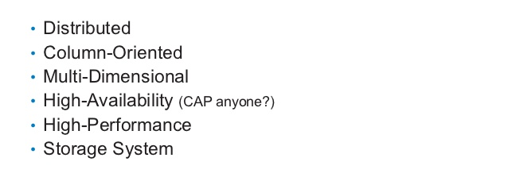
HBase??

Slide 38
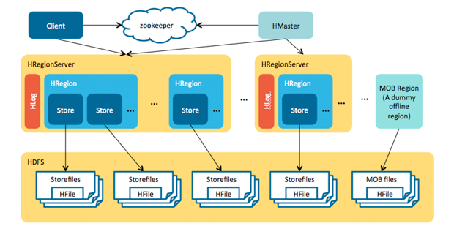
HBase Architecture??

Slide 39
Hive and HBase Integration

Slide 41
Survey

